Slide 1
SourceAmerica Annual Conference
Thomas K. Lehrich
Inspector General
U.S. AbilityOne Commission
Virtual Meeting
May 20, 2021

Slide 2
Roadmap
Semiannual Report to Congress
Virtual NPA Visits
Performance Audits - Program/CNAs:
CNA Selection of NPAs for Project Assignment and Allocation of Orders
Procurement List Addition Process and Procedures
Audit of the U.S. AbilityOne Compliance Program
898 Panel Continuity in 2021
Discussion questions from the Community

Slide 3
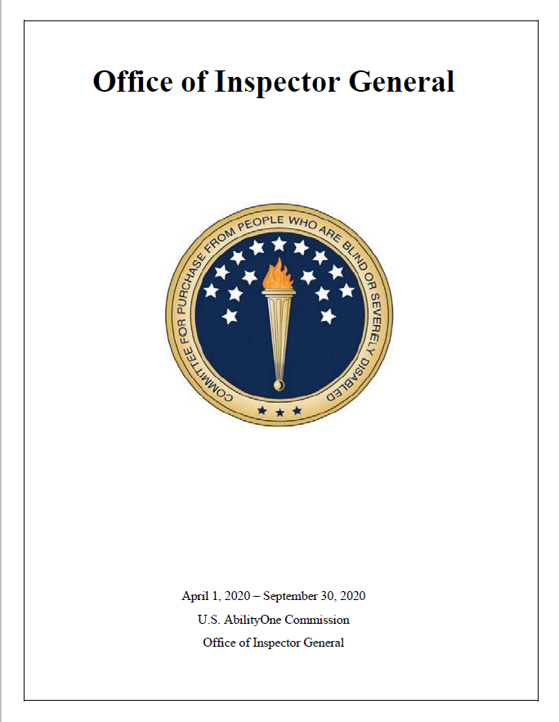
OIG - Semiannual Report to Congress (SAR)
SAR to be issued in May 2021 for period covering October 1, 2020 – March 31, 2021
Theme: Pivotal Stage
Previous SAR issued covered
April 1, 2020 – September 30, 2020
Theme: The Future: Tell Your Own Story

Slide 4
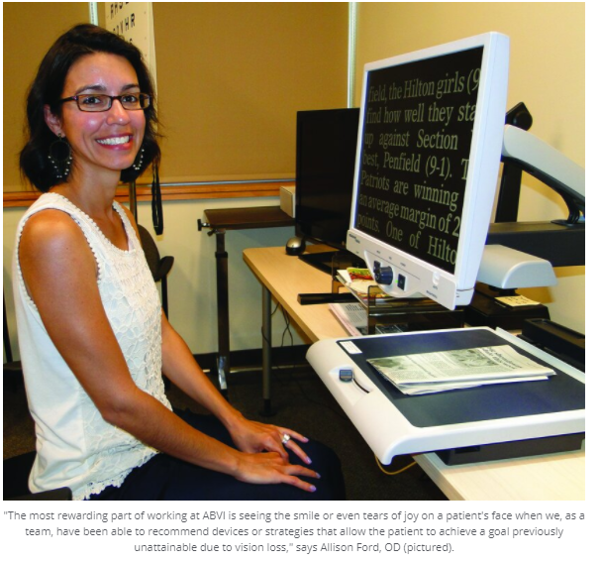
Virtual NPA Visits
Goodwill of the Finger Lakes
Founded as Association of Blind or Visually Impaired (ABVI) in 1911
Joined Goodwill Industries International in 1994
Brevard Achievement Center (BAC)
Founded in 1968 to service a part of Florida void of training and work opportunities for people with disabilities
Participated in 898 Panel Virtual Visits, including Skookum

Slide 5
Audit of the CNA Selection of NPAs for Project Assignment and Allocation of Orders
Audit Objective: Our objective was to assess the extent to which the implementation of the project assignment and allocation process by the CNAs is effective and follows applicable laws and regulations as well as established policies and procedures.
Results in Brief: the CNAs’ project distribution processes were generally effective and followed applicable laws, regulations, and established guidance from the Commission. However, CNAs’ distribution processes could be improved with:
updated guidance,
better management, and
additional oversight from the Commission.
The audit report identified several improvement areas and offered seven recommendations to help the Commission improve its controls over the CNAs’ project distribution processes and their effectiveness in helping the Commission.

Slide 6
Audit of the Procurement List Addition Process, Procedures, and Practices
The audit will assess:
The effectiveness of the policies, procedures, and practices employed by the Commission when approving the addition or removal of products and services for the Procurement List, and
CNAs’ processes for producing and providing procurement list addition packages
Audit Report expected completion by May/June 2021
Determine whether the Procurement List addition process is transparent and performed efficiently, effectively, and in compliance with applicable laws, regulations, and policies
Assess the effectiveness of the Fair Market Price guidance as well as how effective PLIMS supports the program

Slide 7
Audit of the AbilityOne Compliance Program
This audit will determine whether the Compliance Program has been implemented effectively.
Review laws, regulations, policies, and procedures applicable to the Compliance Program
Conduct interviews with key personnel
Analyze data, reports, and other supporting documentation related to compliance reviews

Slide 8
898 Panel Continuity in 2021
IG Subcommittee has completed both its 898 Panel recommendations
The team brought the recommendations further to expand AbilityOne contract training
As the work of the 898 Panel is completed, there are opportunities to identify and leverage recommendations that will continue after sunset of the Panel
The key continuation items we have identified are:
Commission's successful implementation of recommendations by 898 Panel
Focus on continuous updating of the training
Leverage training to reduce program erosion; and
Ensure training is available and expanded government-wide
both within and outside of DoD

Slide 9
Q&A
Thank you from the OIG team!

Slide 10
Questions & Answers
Question 1
You have created an oversight office from scratch, improving the Program.
What are the areas OIG will focus on in the future?

Slide 11
Questions & Answers
Question 2
The OIG has completed a number of NPA visits to learn more about the NPAs and the Program.
What are the main things you learned in going to the NPAs?

Slide 12
Questions & Answers
Question 3
Virtual NPA visits - are they here to stay? What is your prediction?

Slide 13
Questions & Answers
Question 4
You are a statutory member of the 898 Panel –
What do you see as the outcomes for the Program as the 898 Panel goes into the final year of its work?

Slide 14
Questions & Answers
Question 5
The OIG mission is to detect and prevent waste, fraud, and abuse.
How should an NPA report a problem?
How does the OIG hotline reporting process work?

Slide 15
Thank you from the OIG Team !
OIG Hotline Toll-Free Number:
(844) 496-1536
Email a hotline complaint:
Hotline@oig.abilityone.gov
Submit a complaint on our online Portal

