Slide 1
U.S. AbilityOne Commission Meeting
Thomas K. Lehrich
Inspector General
Virtual Meeting
January 14, 2021

Slide 2
Agenda - Roadmap
OIG 2020 Year End Review
Top Management Challenges Report - Issued November 2020
Phases of Oversight
Performance Audits - Program/CNAs
Procurement List Addition Process and Procedures
CNA Selection of Nonprofit Agencies for Project Assignment and Allocation of Orders
Audit of the U.S. AbilityOne Compliance Program
Semiannual Report to Congress – Issued November 2020
NPA Virtual Visits

Slide 3
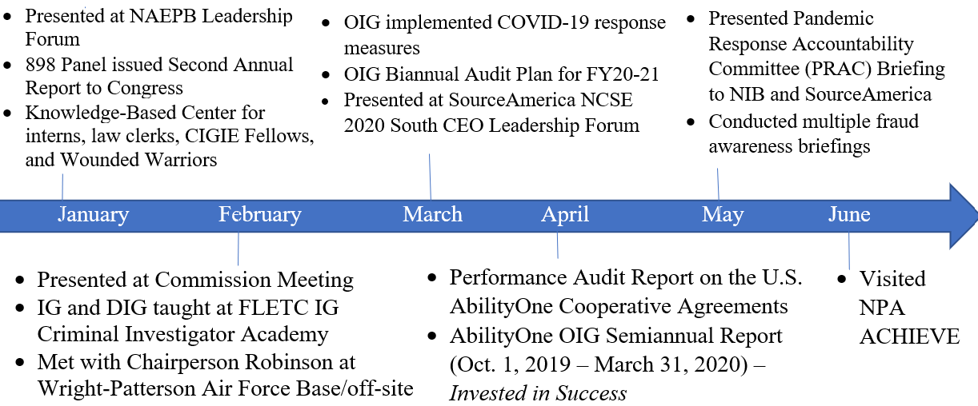
OIG Overview of 2020

Slide 4
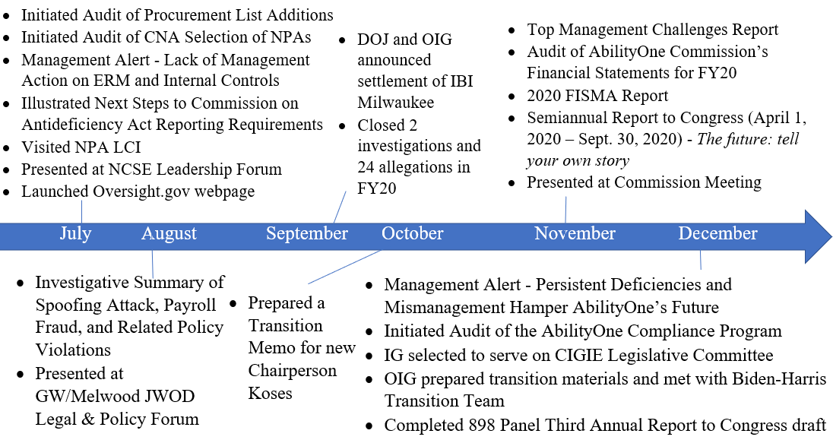
OIG Overview of 2020

Slide 5
OIG Overview of 2020

Slide 6
Top Management Challenges Report
Management Challenge 1
The Commission is challenged with allocation of roles, resources,
and responsibilities among the Commission Senior Staff
Management Challenge 2
Successful implementation of the Section 898 Panel recommendations

Slide 7
Top Management Challenges Report
Management Challenge 3
Addressing Antideficiency Act Violations and Strengthening Financial Management
Management Challenge 4
Higher Level of Transparency Needed to Enhance Confidence in the Program
Management Challenge 5
Erosion of Statutory Program Authority

Slide 8
Top Management Challenges Report
Management Challenge 6
Implementation of Cooperative Agreements with CNAs
Management Challenge 7
Establishing an Enterprise-wide Risk Management Framework
Management Challenge 8
Enhancement of Program Compliance:
Essential and basic areas of program compliance are lacking

Slide 9
Phases of Oversight
Phase I
Phase II
Phase III

Slide 10
Audit of the Procurement List Addition Process, Procedures, and Practices
This is a new audit:
Entrance Conference was held on November 11th
The audit will assess the effectiveness of the policies, procedures, and practices employed by the Commission when approving the addition or removal of products and services for the Procurement List
CNAs’ processes for producing and providing procurement list addition packages

Slide 11
Audit of the Procurement List Addition Process, Procedures, and Practices
The Audit will determine whether the Procurement List addition process is transparent, and performed efficiently, effectively, and in compliance with applicable laws, regulations, and policies
Assess the effectiveness of the Fair Market Price guidance as well as how effective PLIMS supports the program
Audit Report expected completion by second quarter 2021

Slide 12
Audit of the CNA Selection of NPAs for Project Assignment and Allocation of Orders
Field work is almost complete, and report is expected in February
Assess the extent to which the implementation of the project assignment and allocation process by the CNAs is effective and follows established Commission policies
Examine the Commission and CNAs’ policies and procedures as well as best practices for making recommendations to the Commission for NPAs’ project assignments and allocation of orders

Slide 13
Audit of the AbilityOne Compliance Program
This audit will determine whether the Compliance Program has been implemented effectively to provide reasonable assurance of NPA and CNA compliance with applicable laws, regulations, and policies
Review laws, regulations, policies, and procedures applicable to the Compliance Program
Conduct interviews with key personnel
Analyze data, reports, and other supporting documentation related to compliance reviews

Slide 14
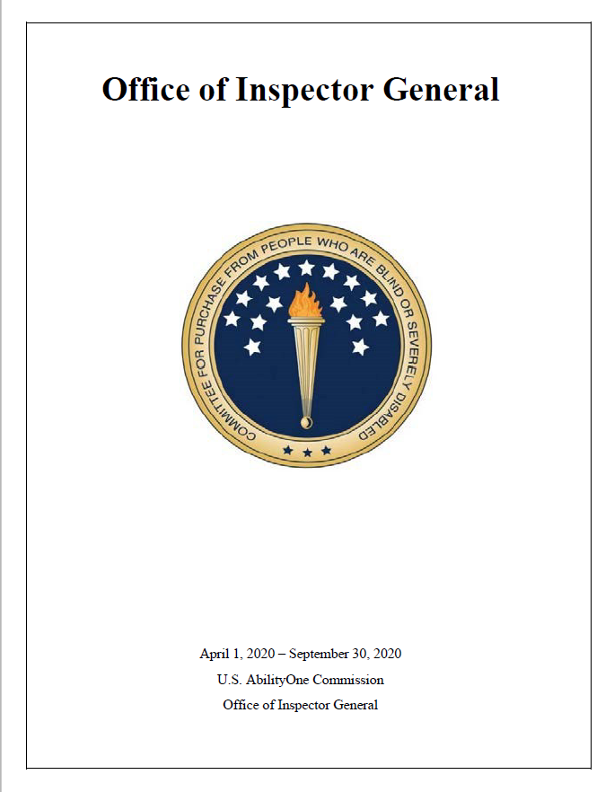
Semiannual Report to Congress April 1, 2020 – September 30, 2020
Theme
The Future: Tell Your Own Story
Previous Themes
- Invested in Success
- Steps to Start-Up
- Sustainability and Innovation
- Hitting our Stride

Slide 15
OIG Program Visits to Understand the Business of AbilityOne

Slide 16
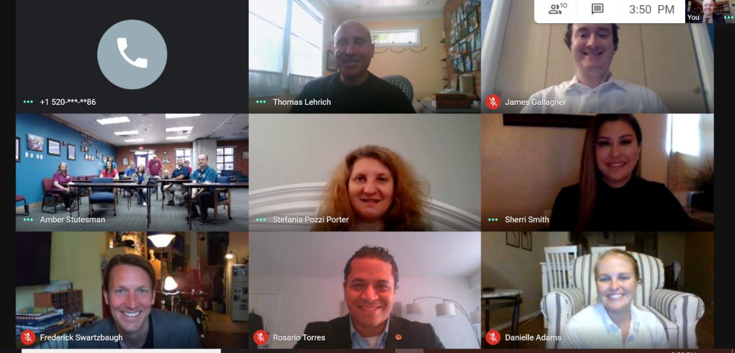
Preparations for NPA Virtual Visit
Select and test virtual platform for visit
Develop a visit agenda
Prepare and provide read-ahead content by both sides to NPAs and OIG, including high-impact OIG work products
Interactive discussions with leadership, Board of Directors, and program participants
Active video tour of the facilities
Post-visit meeting and follow-up

Slide 17
Q&A
Thank you from the OIG team!

