Slide 1
U.S. AbilityOne Commission Meeting
Thomas K. Lehrich
Inspector General
U.S. AbilityOne Commission
Virtual Meeting
July 8, 2021

Slide 2
Roadmap
Semiannual Report to Congress
In-Person NPA Visits- Pride Industries and NBI
Two-Year Audit Plan Issued
Performance Audits - Program/CNAs:
CNA Selection of NPAs for Project Assignment and Allocation of Orders
Procurement List Addition Process and Procedures
Audit of the U.S. AbilityOne Compliance Program
898 Panel Continuity in 2021

Slide 3
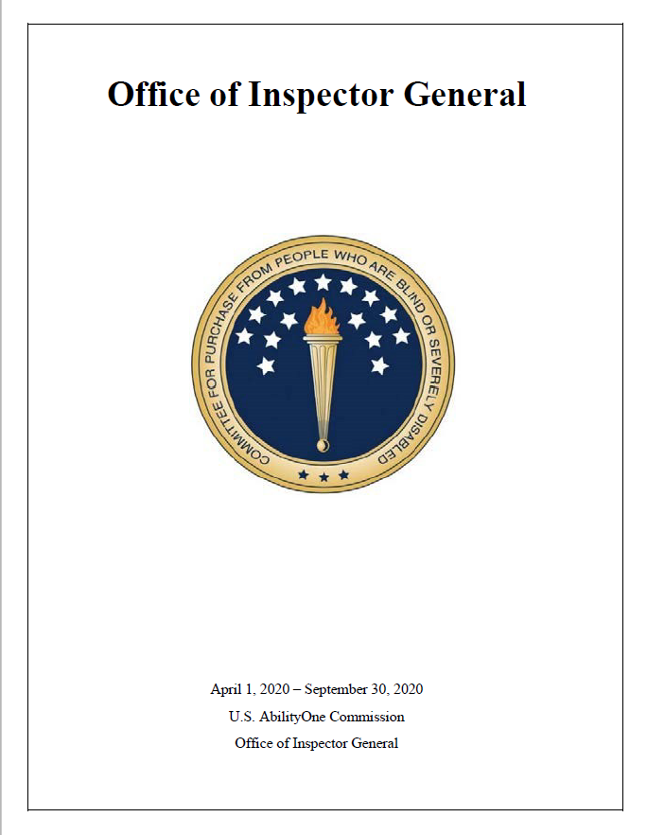
OIG - Semiannual Report to Congress (SAR)
SAR issued in May 2021 covered October 1, 2020 – March 31, 2021
Theme: Pivotal Stage
Previous SAR issued covered
April 1, 2020 – September 30, 2020
Theme: The Future: Tell Your Own Story

Slide 4
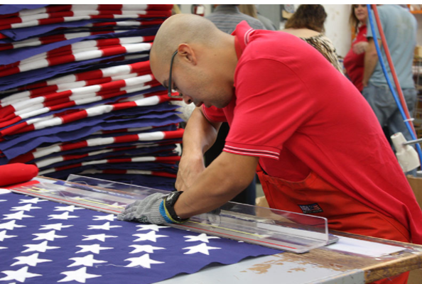
In-Person NPA Visits
OIG completed two knowledge visits with SourceAmerica NPAs in Northern California
Pride Industries
NPA with over 6,000 employees started in 1966 by a small group of parents wanting their disabled children to have vocational and rehabilitation opportunities.
Toured Travis AFB and met with over a dozen Program participants, and learned about three contracts: custodial, landscaping, and food services.
North Bay Industries
Founded in 1968 to assist adults with disabilities and provide employment in their communities.
Demonstrated assistive devices, including automated driving landscaping machinery and flag manufacturing which produces 90,000 American flags a year.

Slide 5
Two-Year Audit Plan Issued
Effort led and completed by our Assistant Inspector General for Auditing.
New biennial audit plan issued in June.
Maps out audits OIG plans over the next 2 years (2022-2023).
OIG utilized a comprehensive risk-based methodology to inform audit planning and future engagements.

Slide 6
Audit of the CNA Selection of NPAs for Project Assignment and Allocation of Orders
Audit Objective: Our objective was to assess the extent to which the implementation of the project assignment and allocation process by the CNAs is effective and follows applicable laws and regulations as well as established policies and procedures.
Results in Brief: the CNAs’ project distribution processes were generally effective and followed applicable laws, regulations, and established guidance from the Commission. However, CNAs’ distribution processes could be improved with:
updated guidance,
better management, and
additional oversight from the Commission.
The audit report identified several improvement areas and offered seven recommendations to help the Commission improve its controls over the CNAs’ project distribution processes and their effectiveness in helping the Commission.

Slide 7
Audit of the Procurement List Addition Process, Procedures, and Practices
Draft Report issued - 13 recommendations for improvement of operation and management of Procurement List (PL) process.
Final Report expected August 2021.
The audit objective was to determine whether the PL addition process is transparent and performed efficiently, effectively, and in compliance with applicable laws, regulations, and policies.
To answer the objective, auditors assessed:
Effectiveness of the policies, procedures, and practices employed by the Commission when approving the addition or removal of products and services for the PL, and CNAs’ processes for producing and providing procurement list addition packages.
Effectiveness of the Fair Market Price guidance as well as how effective PLIMS supports the program.

Slide 8
Audit of the AbilityOne Compliance Program
This audit will determine whether the Compliance Program has been implemented effectively to provide reasonable assurance of NPA and CNA compliance with applicable laws, regulations, and policies.
To answer our objective, we will:
Review laws, regulations, policies, and procedures applicable to the Compliance Program.
Conduct interviews with key personnel.
Analyze data, reports, and other supporting documentation related to compliance reviews.

Slide 9
898 Panel Continuity in 2021
IG Subcommittee has completed both its 898 Panel recommendations
The team brought the recommendations further to expand AbilityOne contract training
As the work of the 898 Panel is completed, there are opportunities to identify and leverage recommendations that will continue after sunset of the Panel
The key continuation items we have identified are:
Commission's successful implementation of recommendations by 898 Panel
Focus on continuous updating of the training
Leverage training to reduce program erosion; and
Ensure training is available and expanded government-wide
both within and outside of DoD

Slide 10
Q&A
Thank you from the OIG team!

