Slide 1
U.S. AbilityOne Commission Meeting
Thomas K. Lehrich
Inspector General
Virtual Meeting
April 8, 2021

Slide 2
Roadmap
Semiannual Report to Congress
Virtual NPA Visits
DOJ Law Enforcement Authority Application
Performance Audits - Program/CNAs
CNA Selection of NPAs for Project Assignment and Allocation of Orders
Procurement List Addition Process and Procedures
Audit of the U.S. AbilityOne Compliance Program
CIGIE Top Management Challenges Facing Multiple Federal Agencies
898 Panel Continuity in 2021

Slide 3
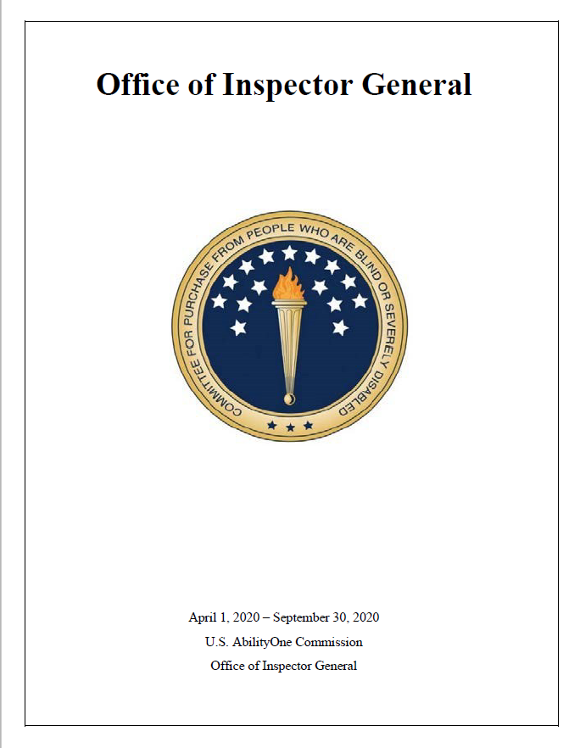
Semiannual Report to Congress (SAR)
SAR to be issued in April 2021 for period covering October 1, 2020 – March 31, 2021.
Theme: Pivotal Stage
Previous SAR issued covered
April 1, 2020 – September 30, 2020.
Theme: The Future: Tell Your Own Story

Slide 4
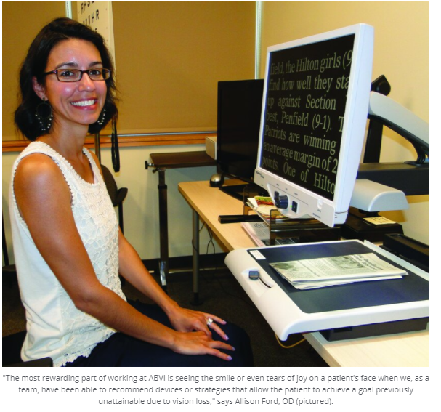
Virtual NPA Visits
Toured Goodwill of the Finger Lakes – April 5th, 2021
Founded as Association of Blind or Visually Impaired (ABVI) in 1911
Joined Goodwill Industries International in 1994
700+ member team offers services and programs to help over 150,000 people annually live an independent and meaningful life, including:
serves people with vision loss and their families
2-1-1/LIFELINE – 24/7 information, referral, and crisis
intervention hotline
Good Neighbor Program – supports work-ready wardrobe programs, green initiatives, and partnering with other community agencies
Job Readiness Program – provides job training and placement opportunities for individuals trying to overcome obstacles keeping them from entering or remaining in the workforce
Participated in 898 Panel Virtual Visits, including Skookum

Slide 5
OIG Program Visits to Understand the Business of AbilityOne

Slide 6
OIG Law Enforcement Authority Application
The IG Act empowers Inspectors General to apply directly to the Attorney General for law enforcement authority
OIG initiated the formal application process with the Department of Justice
DOJ accepted our application and is working with the OIG

Slide 7
Audit of the CNA Selection of NPAs for Project Assignment and Allocation of Orders
Audit Objective: Our objective was to assess the extent to which the implementation of the project assignment and allocation process by the CNAs is effective and follows applicable laws and regulations as well as established policies and procedures.
Results in Brief: the CNAs’ project distribution processes were generally effective and followed applicable laws, regulations, and established guidance from the Commission. However, CNAs’ distribution processes could be improved with:
updated guidance
better management, and
additional oversight from the Commission
The audit report identified several improvement areas and offered seven recommendations to help the Commission improve its controls over the CNAs’ project distribution processes and their effectiveness in helping the Commission.

Slide 8
Audit of the CNA Selection of NPAs for Project Assignment and Allocation of Orders
Additional Findings:
The Commission’s policy 51.301 is outdated and does not define the meaning of the terms equitable and transparent distribution of projects although GAO recommended updating this policy in 2013
The CNAs’ adoption of the interim test pilot policy has been delayed because the Commission has not clarified whether this is required and has not provided the CNAs with sufficient programmatic guidance on the goals, timelines, and risks for the pilot program

Slide 9
Audit of the CNA Selection of NPAs for Project Assignment and Allocation of Orders
Additional findings, continued:
Resolution of CNAs following stated Commission guidance requires the Commission addressing several issues that remain unresolved since 2018
The Commission has not studied whether different sized NPAs receiving a mix of project opportunities could help increase the number of people employed through the program and the Commission’s understanding of whether project assignments are transparent is limited

Slide 10
Audit of the Procurement List Addition Process, Procedures, and Practices
Fieldwork is in progress and near completion
The audit will assess:
The effectiveness of the policies, procedures, and practices employed by the Commission when approving the addition or removal of products and services for the Procurement List, and
CNAs’ processes for producing and providing procurement list addition packages

Slide 11
Audit of the Procurement List Addition Process, Procedures, and Practices
The Audit will determine whether the Procurement List addition process is transparent and performed efficiently, effectively, and in compliance with applicable laws, regulations, and policies
Assess the effectiveness of the Fair Market Price guidance as well as how effective PLIMS supports the program
Audit Report expected completion by May/June 2021

Slide 12
Audit of the AbilityOne Compliance Program
This audit will determine whether the Compliance Program has been implemented effectively to provide reasonable assurance of NPA and CNA compliance with applicable laws, regulations, and policies
Review laws, regulations, policies, and procedures applicable to the Compliance Program
Conduct interviews with key personnel
Analyze data, reports, and other supporting documentation related to compliance reviews

Slide 13
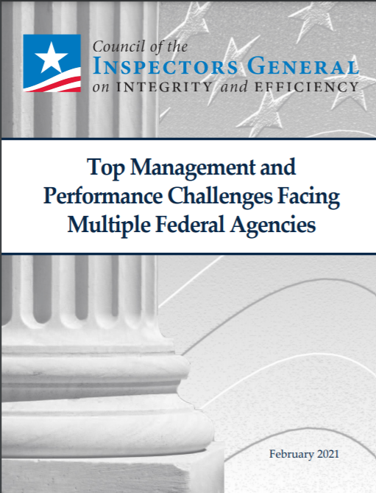
CIGIE Top Management and Performance Challenges Facing Multiple Federal Agencies
Premier resource for the community, the Administration, and other stakeholders that identify and analyze cross-cutting challenges in government
Referenced AbilityOne OIG analysis on Enterprise Risk Management as a cross-cutting government challenge
Referenced AbilityOne OIG report on how the allocation of roles, responsibilities, and resources among the Commission senior staff creates challenges to timely implement policies and initiatives, effectively execute changes, and support growth

Slide 14
CIGIE Top Management and Performance Challenges Facing Multiple Federal Agencies
Cross-Cutting Challenges:
Performance Management and Accountability
Homeland Security, Disaster Management, and COVID-19
Procurement Management
Grant Management
Information Technology Security and Management
Human Capital Management
Financial Management

Slide 15
898 Panel Continuity in 2021
IG Subcommittee has completed both its 898 Panel recommendations
The team brought the recommendations further to expand AbilityOne contract training
As the work of the 898 Panel is completed, there are opportunities to identify and leverage recommendations that will continue after sunset of the Panel
The key continuation items we have identified are:
Commission's successful implementation of recommendations by 898 Panel
Focus on continuous updating of the training
Leverage training to reduce program erosion; and
Ensure training is available and expanded government-wide
both within and outside of DoD

Slide 16
Q&A
Thank you from the OIG team!

