Slide 1
Office of Inspector General
U.S. AbilityOne Commission Meeting
Thomas K. Lehrich
Inspector General
Commission HQ, Crystal City
February 12, 2020

Slide 2
Agenda
Results of Recent Oversight Work and Reports Issued
Semiannual Report to Congress
NPA Visits
Top Management Challenges Report
Performance Audit of the Cooperative Agreements
Phases of Oversight
Questions and Comments

Slide 3
Roadmap to Oversight
IG Semiannual Report to Congress – April 1, 2019 to September 30, 2019
NPA Visits to Understand the Business of the AbilityOne Program
Top Management and Performance Challenges Report– December 2, 2019
Performance Audit of the AbilityOne Program Fee – December 20, 2019
Performance Audit of the AbilityOne Cooperative Agreements – Est. March 2020
Commission’s Financial Statement Audit – December 13, 2019
Commission’s Federal Information Security Modernization Act (FISMA) Evaluation – November 21, 2019

Slide 4
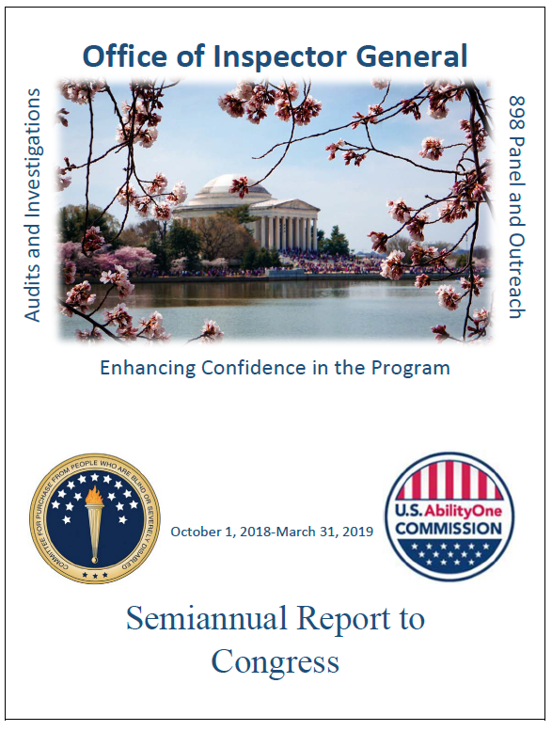
IG Semiannual Report to Congress
April 1st, 2019 – September 30th, 2019
IG Message Theme: Steps to Start-Up
Previous IG Message Themes
Sustainability and Innovation
Hitting our Stride

Slide 5
OIG Program Visits to Understand the Business of AbilityOne
NPA: Nearly Thirty Visits Across the Country
Most Recent Visit:
Seattle Lighthouse
CNA: Over Twenty Five Meetings with CNA Leadership/ CEOs

Slide 6
Top Management and Performance Challenges
Report issued on December 2, 2019 in accordance with the Reports Consolidation Act of 2000.
OIG reports on the most significant management and performance challenges facing the Commission, for inclusion in the Commission’s Performance and Accountability Report (PAR) for fiscal year (FY) 2019.
The challenge areas identified are connected to the Commission’s mission to provide employment and training opportunities in the manufacture and delivery of products and services to the Federal Government of the United States for people who are blind or have significant disabilities.

Slide 7
Top Management and Performance Challenges
Higher Level of Transparency and Communication Needed to Enhance Program Confidence
Erosion of Statutory Program Authority
Implementation of Cooperative Agreements Given Central Nonprofit Agencies (CNAs) Growth
Establishing an Enterprise-Wide Risk Management Framework
Enhancement of Program Compliance

Slide 8
Organizational Governance
The OIG placed Organizational Governance as a watch item as a potential, reportable challenge for the Commission.
The allocation of roles, authorities, and responsibilities among the Commission Senior Staff creates challenges in:
Achieving positive business outcomes such as the ability to implement timely policies and initiatives
Effectively executing changes in the program, and supporting program growth.

Slide 9
Performance Audit of the AbilityOne Program Fee
Performance audit report issued on December 20, 2019
The objective of the audit was to perform a comprehensive analysis of the history and function of the AbilityOne Program Fee, and to determine whether effective and transparent criteria exists with the AbilityOne Program Fee
During fieldwork, the outside auditors:
Reviewed the history and function and audited the procedures and processes
Conducted site visits and interviews at the Commission, NIB, and SourceAmerica
Performed focus groups with 11 NPAs CEOs
Obtained responses to questionnaires from 5 NPAs CEOs
The audit concluded that the Commission did not provide effective criteria related to the AbilityOne Program Fee

Slide 10
Performance Audit of the AbilityOne Program Fee
The audit concluded that the Commission did not provide effective criteria related to the AbilityOne Program Fee
Among the findings were that the management of the fee ceiling determination, and lack of timely implementation of the policies has produced poor outcomes.

Slide 11
Performance Audit of the AbilityOne Program Fee
The report included five recommendations to assist in strengthening the effectiveness for the AbilityOne Program Fee
Policy and procedures on the Program Fee Ceiling criteria and methodology
Policy on the methodology for the CNAs to calculate the Program Fee
Standards to assist the Commission with the development, design, and implementation of timely policies and procedures
Commission workforce analysis to determine Commission staffing requirements
Data analysis on CNAs Fee and Expenditure reports

Slide 12
Performance Audit of the Cooperative Agreements - Update
Audit notification issued on September 27, 2019
The audit objective is to determine whether the Agreements are adequately designed and operating effectively to improve performance and transparency in the AbilityOne Program
Commission
NIB
SourceAmerica
The review will determine whether the performance criteria are reasonable, measurable, and implemented to achieve effective oversight
Fieldwork is underway and report expected in March 2020

Slide 13
Program Management and Operations
Experiencing signs of weakness
Financial Statements
FISMA

Slide 14
Financial Statement Audit
Audit report issued on December 13, 2019 of the Commission’s financial statements and related footnotes.
The audit resulted in an adverse opinion due to significant departures from generally accounting principles and federal reporting requirements, including material misstatements and omissions in the Commission’s financial statements and footnotes.
The misstatements and omissions were material and pervasive, and included the failure to record accounts payable accrual and accurately record other accrued liabilities, which materially misstated the Commission’s beginning and ending balances, and the omission of uncorrected errors in required footnotes.

Slide 15
Financial Statement Audit
The audit report included 18 recommendations to address two material weaknesses, two significant deficiencies, and two findings related to noncompliance with certain provisions of applicable laws and regulations.
Financial statements and footnotes not prepared in accordance with generally accepted accounting principles & OMB Circular A-136 “Financial Reporting Requirements”
Year-end accrued liabilities not estimated or accurately recorded
Improvement needed in the computation of imputed costs
Employee benefits election forms not maintained per OPM requirements
Management assurance was not prepared
Potential anti-deficiency act violation relating to obligation of expired funds

Slide 16
Federal Information Security Modernization Act (FISMA)
Evaluation report issued on November 21, 2019.
The objective of the evaluation was to assess the effectiveness of the Commission’s information security and privacy program as of September 30, 2019.
The overall assessment of the Commission's information security program was deemed not effective because the tested, calculated and assessed maturity levels across the functional and domain areas received an overall rating at Level 3.

Slide 17
898 Panel Activities
IG leads the Inspector General Subcommittee
Worked closely with DOJ for Waste-Fraud-Abuse Subcommittee
IG met with new Chair of 898 Panel, Mr. Kim Herrington
Worked along with Agency on receiving feedback from CNAs and NPAs for implementation of the 898 Panel output
IG presented on 898 Panel recommendations in multiple forums
Second 898 Panel Report expected in September

Slide 18
Phases of Oversight
Phase I
Phase II
Phase III

Slide 19
Thank You
OIG Hotline Toll-Free Number:
(844) 496-1536
Emailing a hotline complaint:
Hotline@oig.abilityone.gov
•
17

