Slide 1
U.S. AbilityOne Commission Meeting
Thomas K. Lehrich
Inspector General
Virtual Meeting
July 17, 2020

Slide 2
Agenda
Virtual NPA Visit to Achieve, located in Yuma, Arizona
Launch of new OIG Webpage in partnership with CIGIE, Postal OIG, and DOJ OIG
Civil Fraud Case Portfolio
Phases of Oversight, Welcoming New OIG Staff, and New Audit Starts

Slide 3
OIG Program Visits to Understand the Business of AbilityOne
NPA: Several OIG Outreach Visits Across the Country

Slide 4
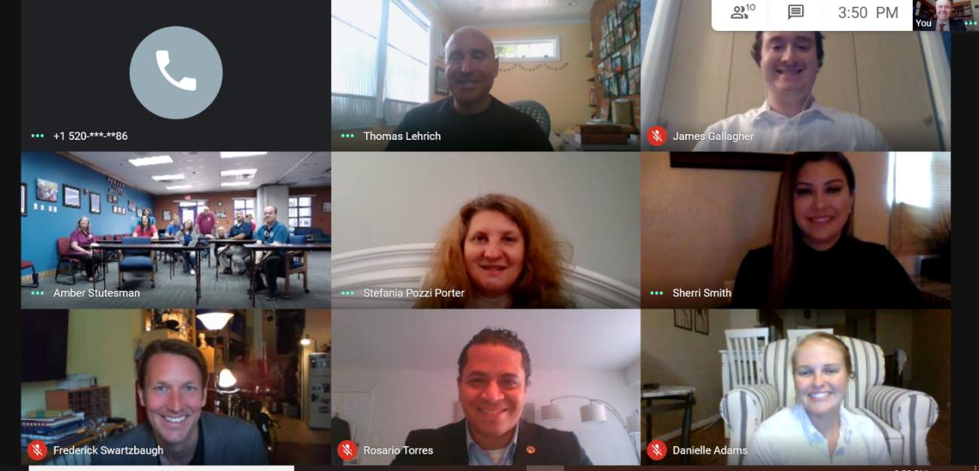
Preparations for NPA Virtual Visit
Selected and tested virtual platform for visit
Developed a visit agenda
Prepared and provided read-ahead content by both sides to Achieve and OIG, including high-impact OIG work products
Interactive discussions with leadership, board of directors, and program participants.
Active video tour of the facilities
Post-visit meeting for any follow-up

Slide 5
ACHIEVE NPA Visit
In existence for over 50 years in the Southwest of rural Arizona
Serves any individual with a developmental disability cognitive, autism, cerebral palsy, and any Wounded Warrior who is enrolled with services through the Department of Economic Security/ Division of Developmental Disabilities or Department of Economic Security/Rehabilitation Services Administration
Offers housing opportunities for individuals who require supported living and are diagnosed with a serious mental illness
Border Patrol Contracts through Homeland Security, providing Janitorial and Grounds Maintenance services
Notes:
https://www.achievehs.org/about.html
https://www.achievehs.org/landscaping.html

Slide 6
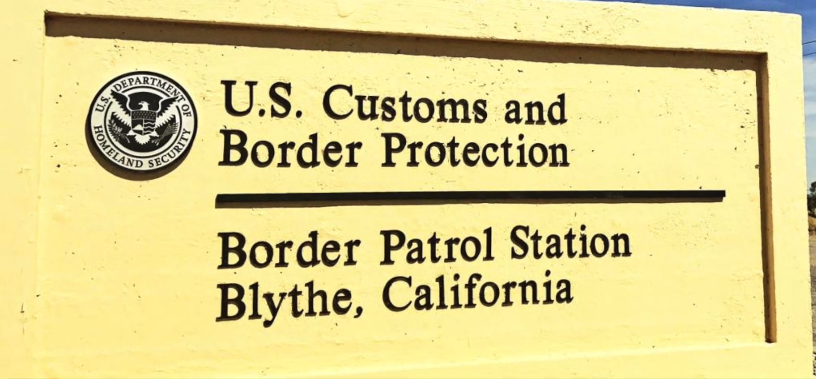
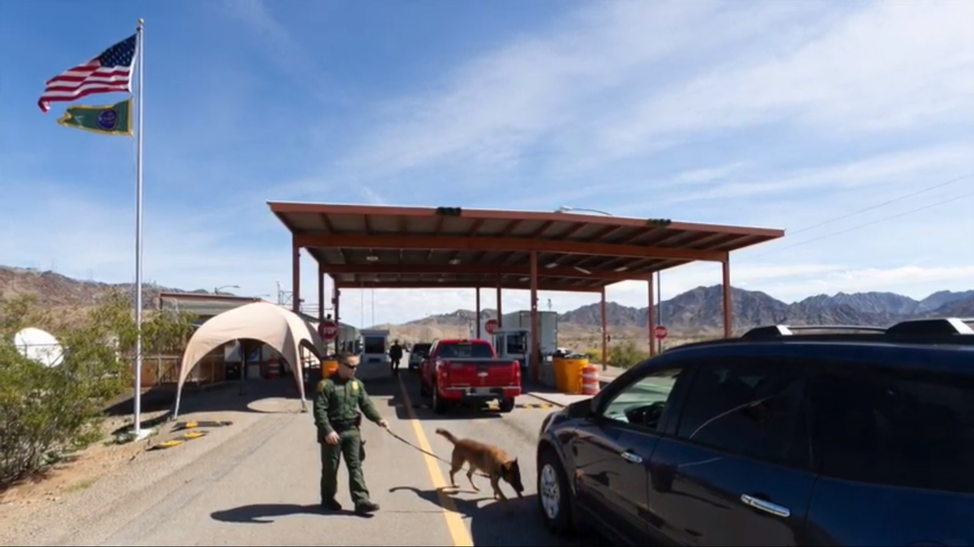
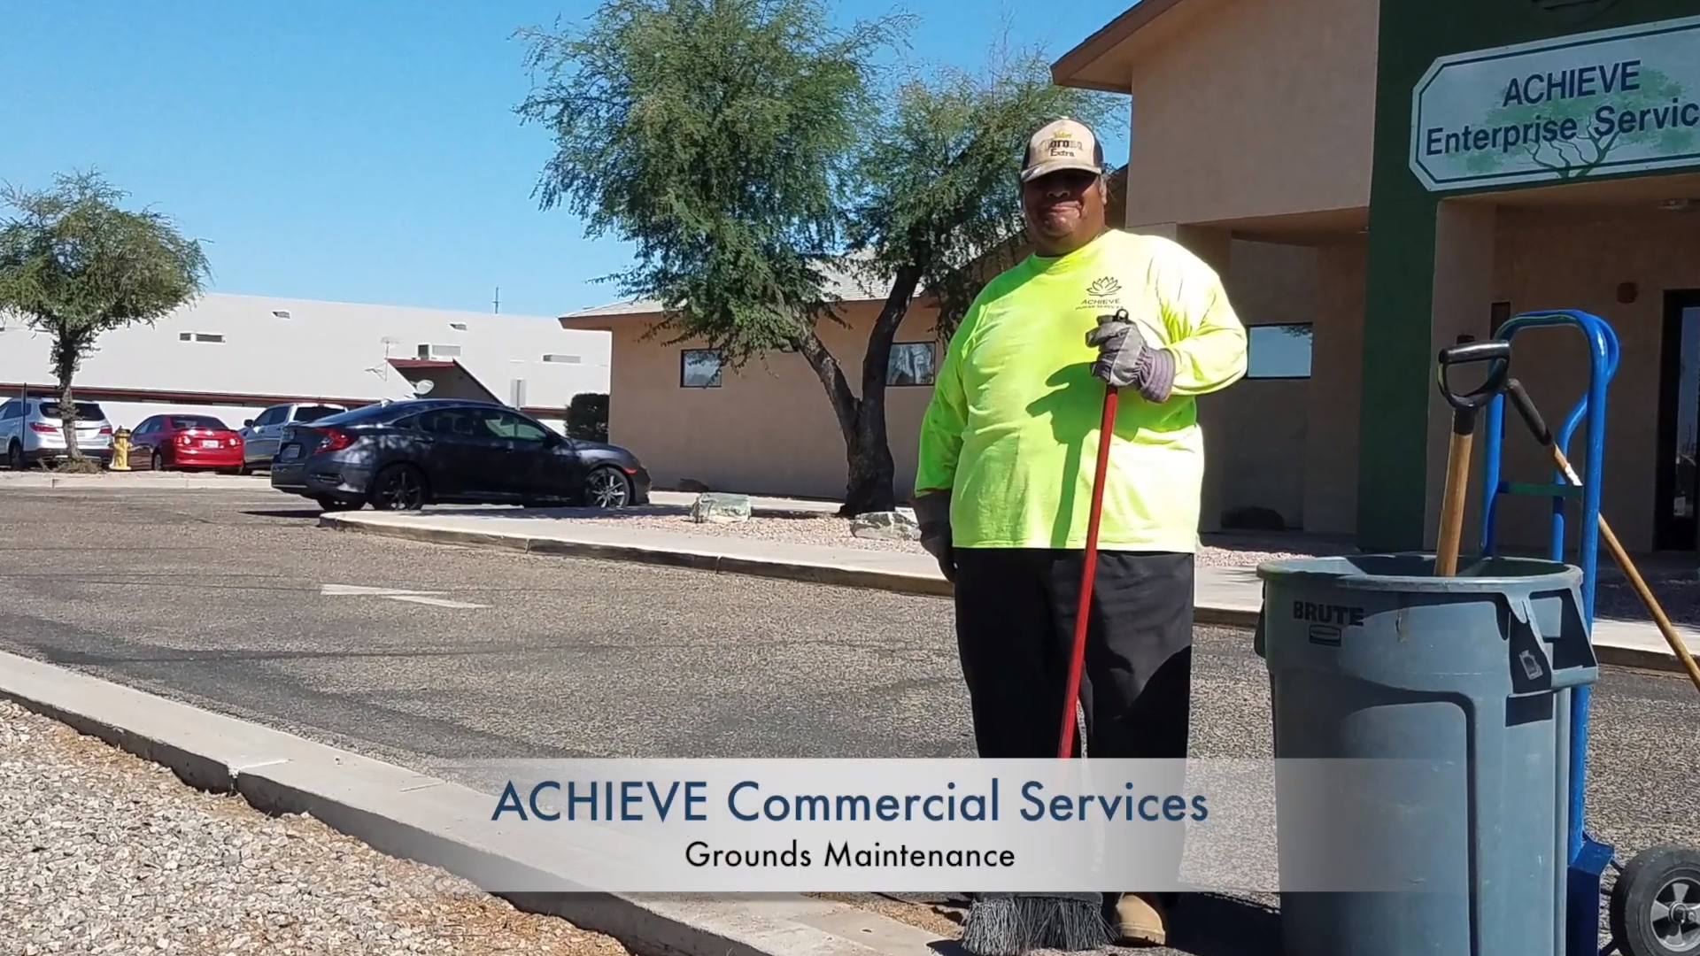
Video Tour of ACHIEVE Facilities and Contracts

Slide 7
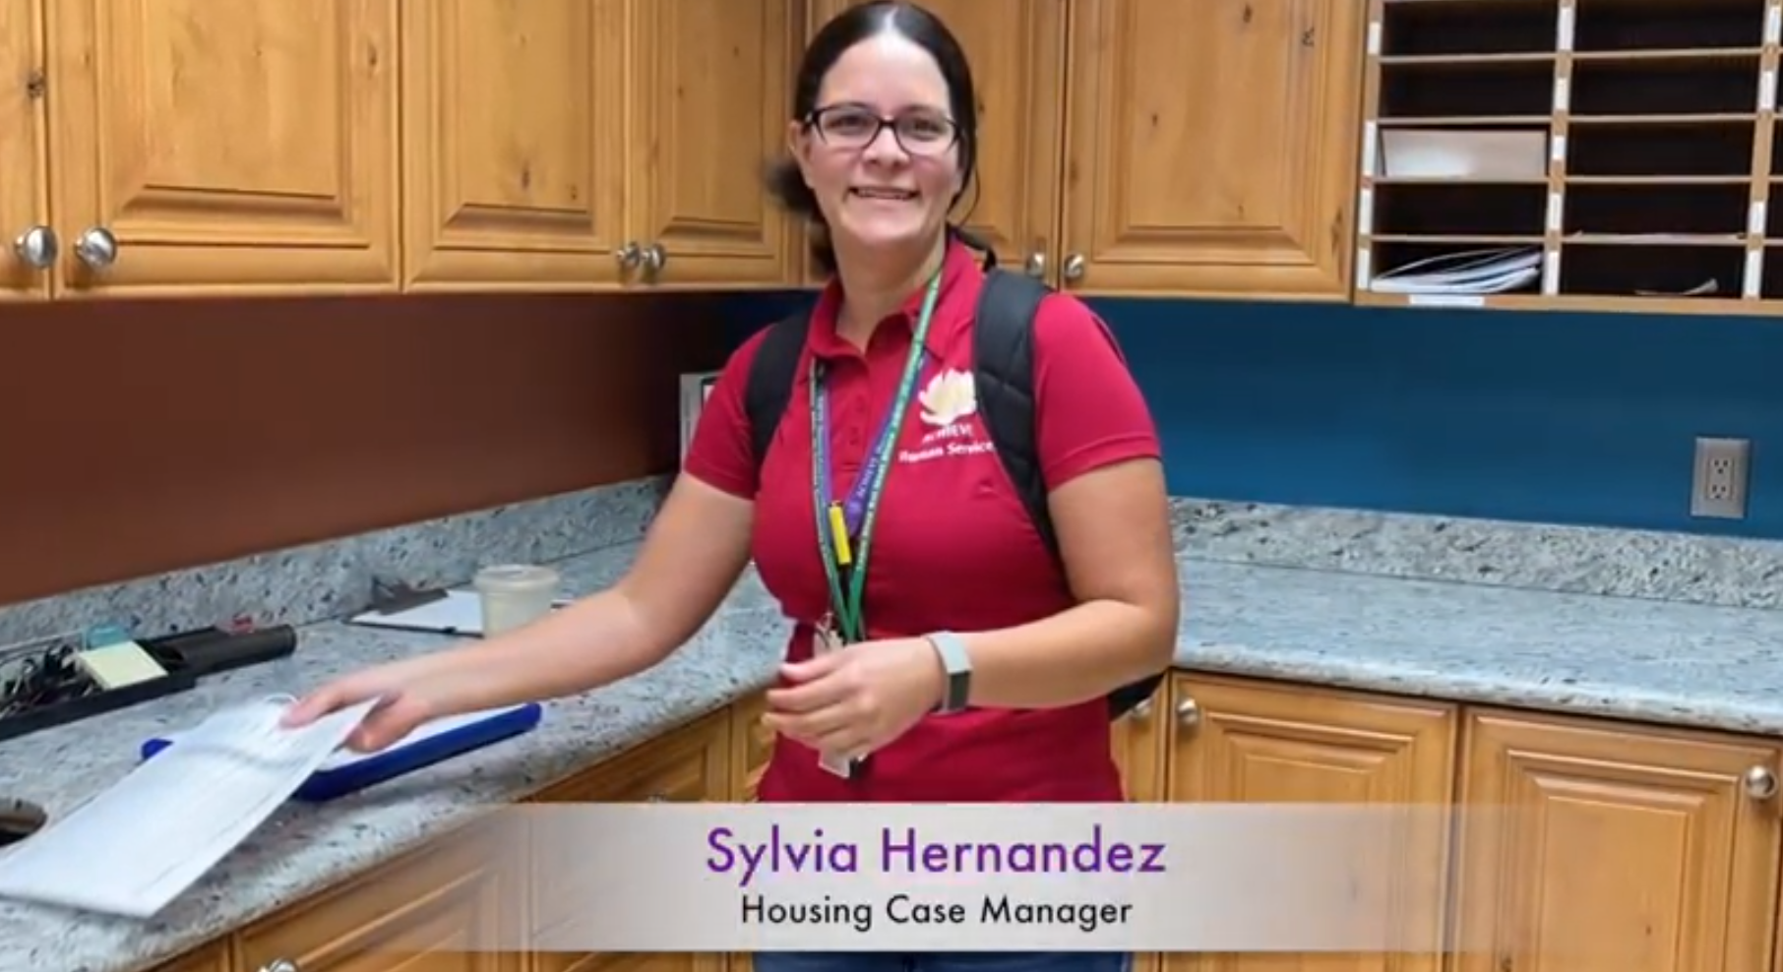
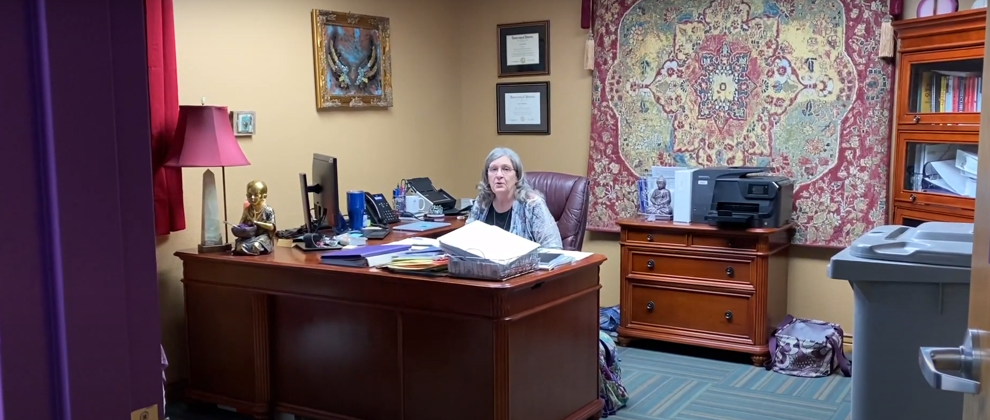
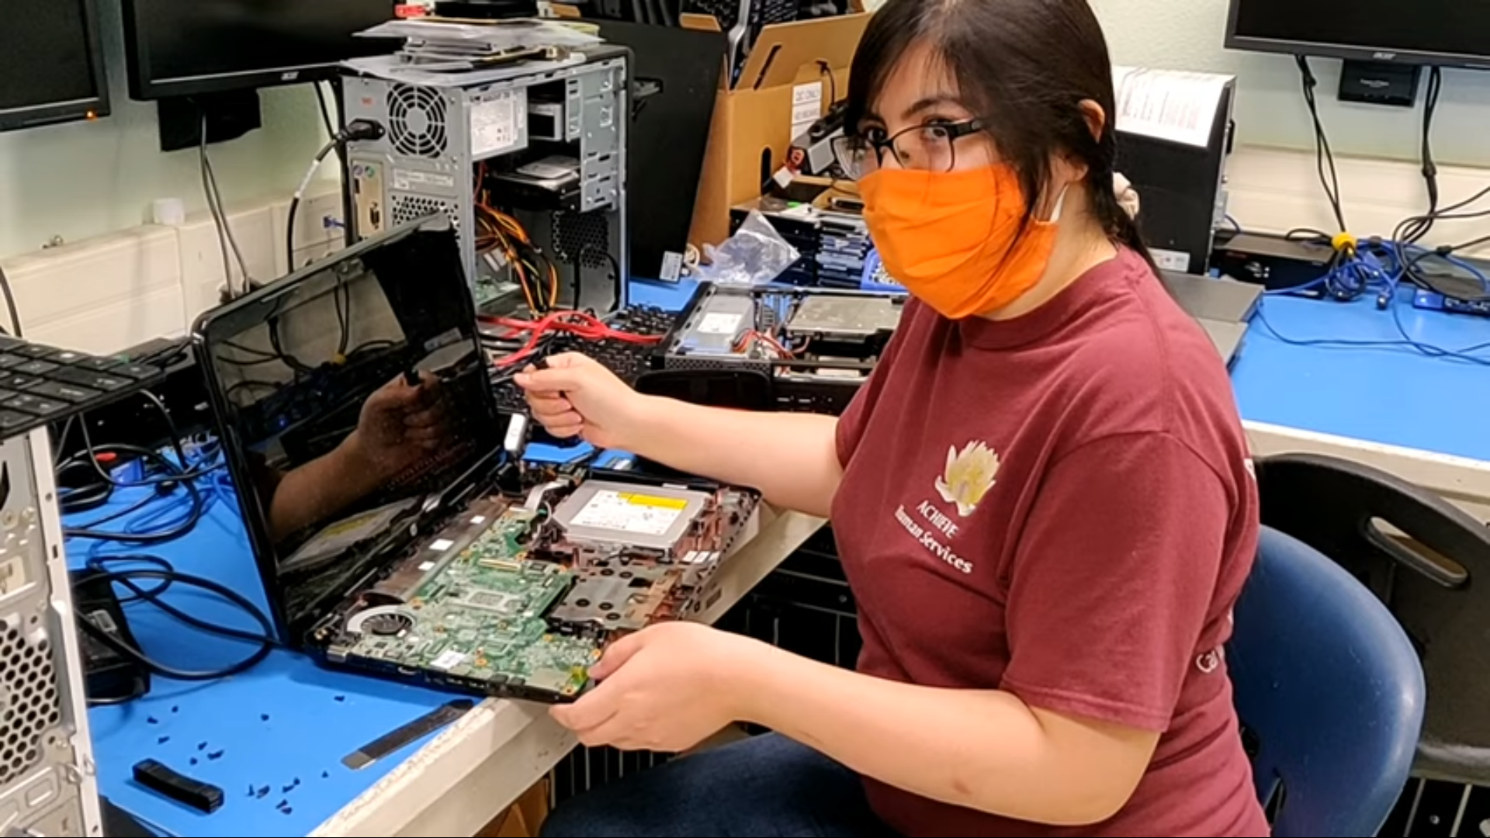
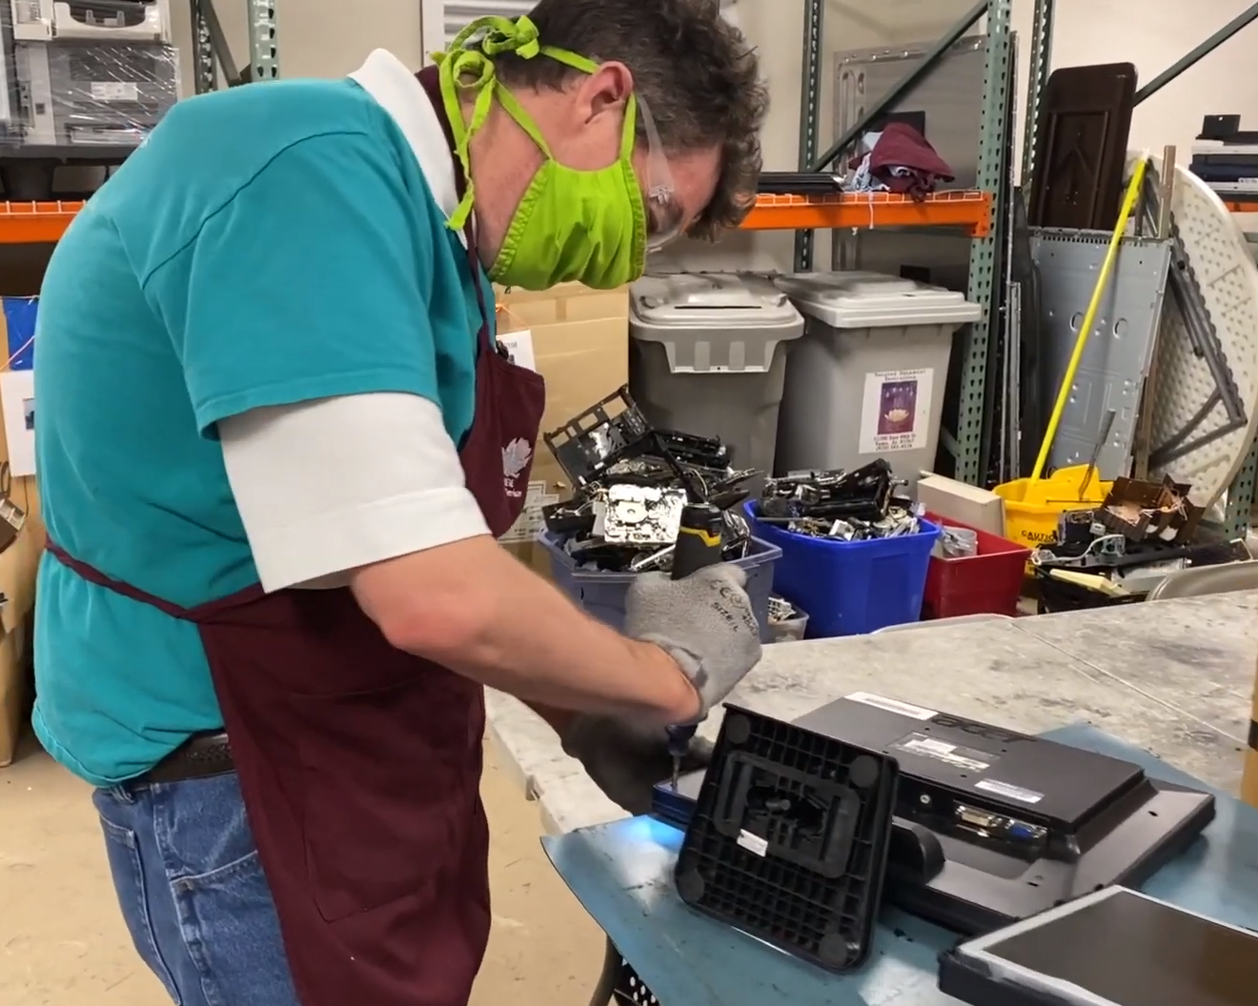
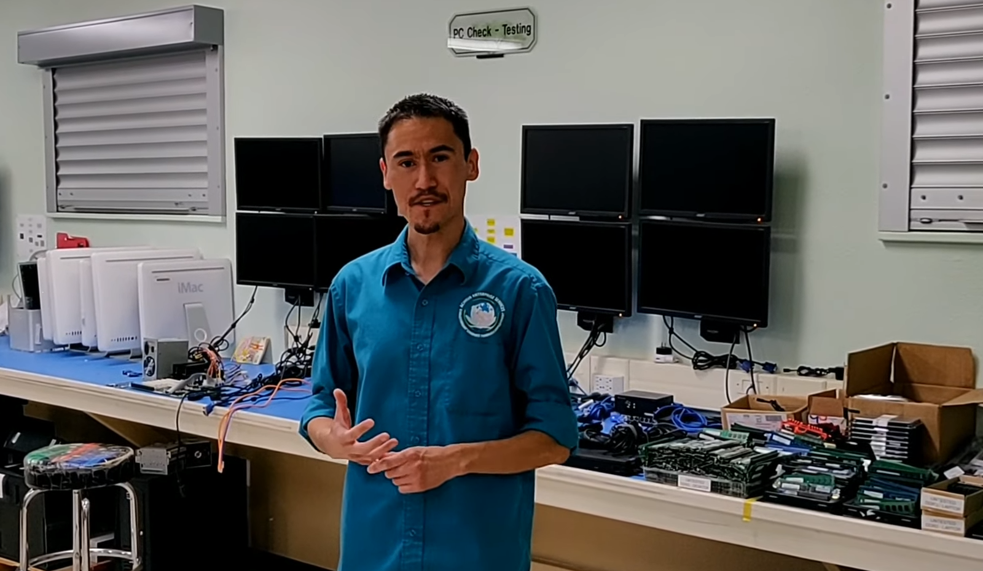
Video Tour of ACHIEVE Facilities and Contracts

Slide 8
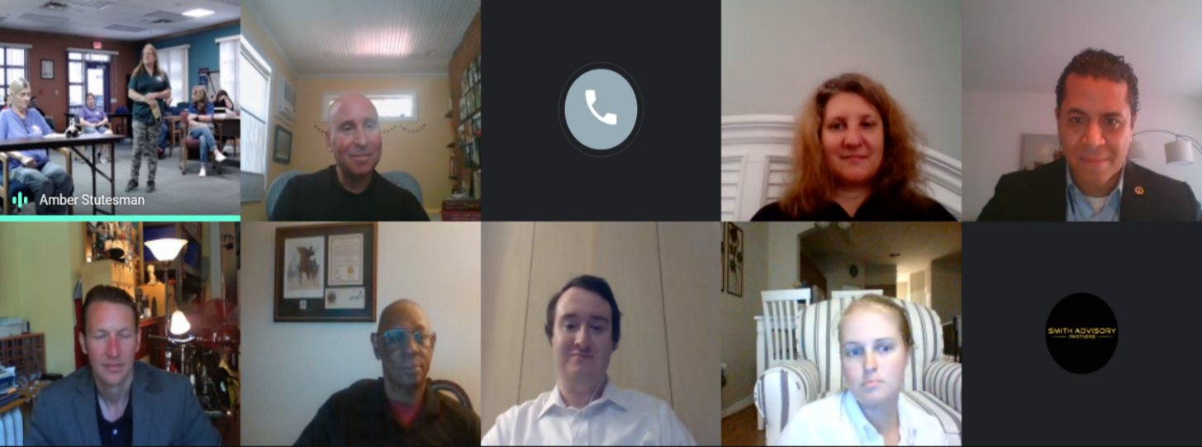
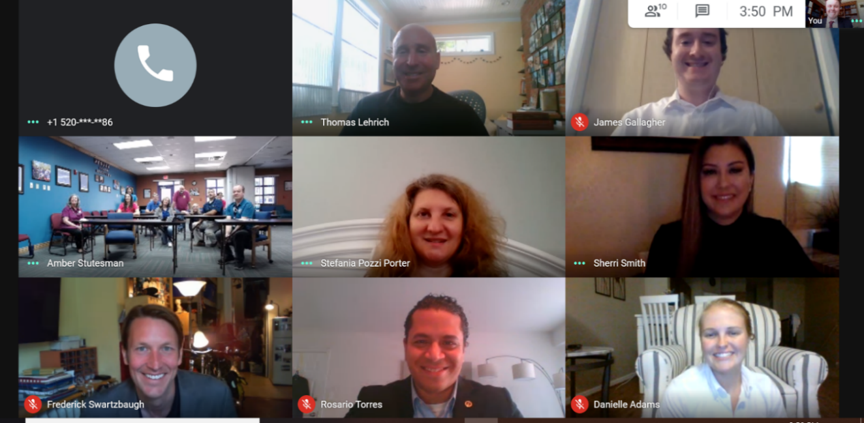
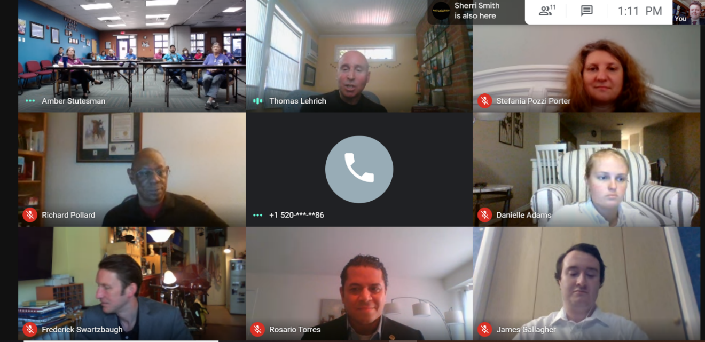
Images from ACHIEVE Visit
Notes:
https://www.achievehs.org/janitorial.html
https://www.achievehs.org/laundry-services.html

Slide 9
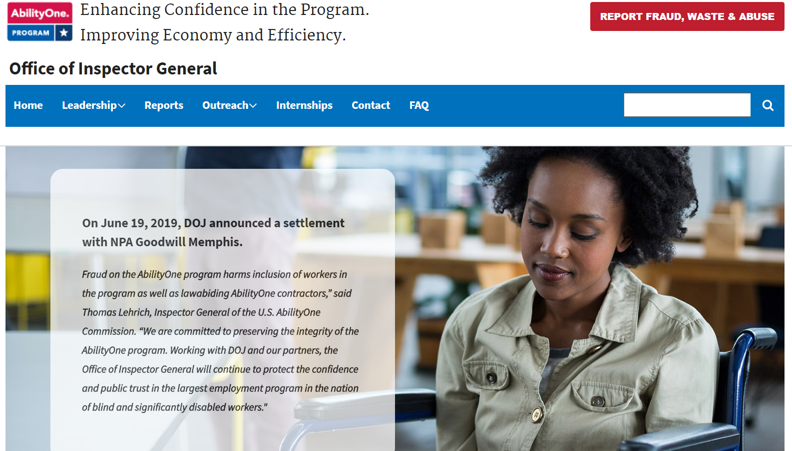
AbilityOne OIG – Website Homepage

Slide 10
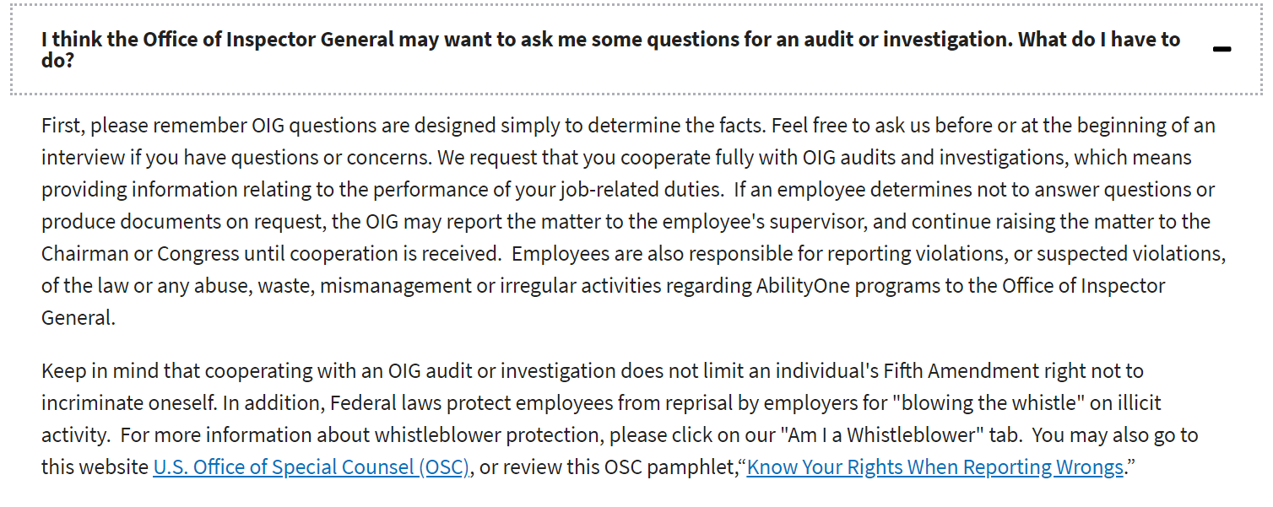
Webpage FAQs

Slide 11
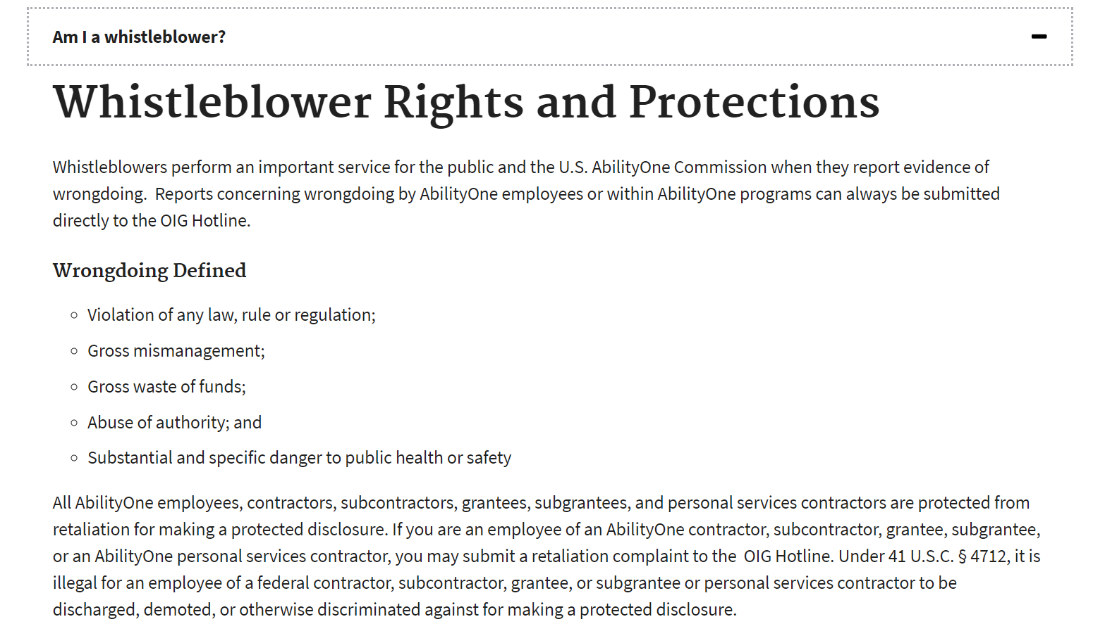
Webpage FAQs Continued

Slide 12
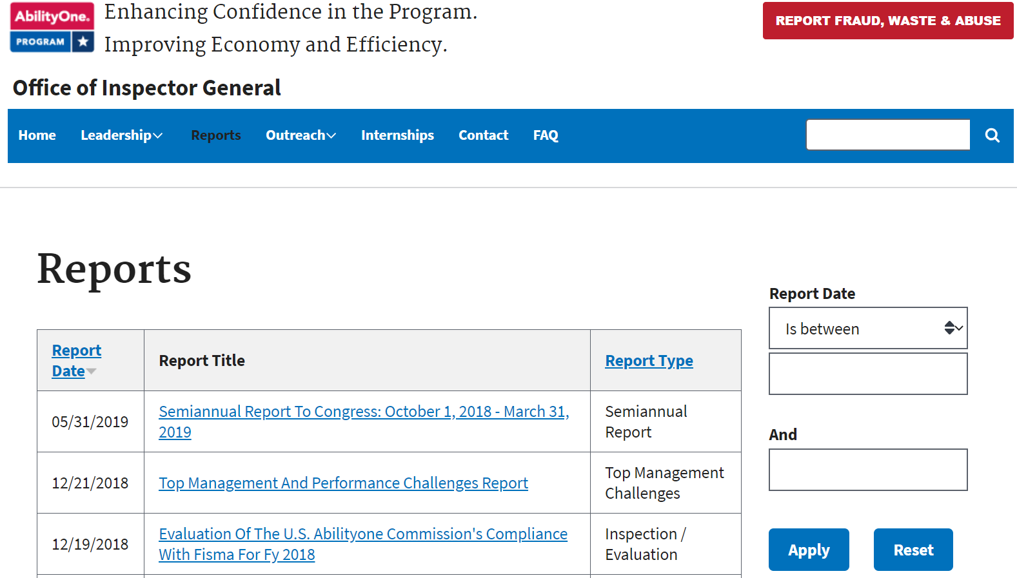
Webpage Reports

Slide 13
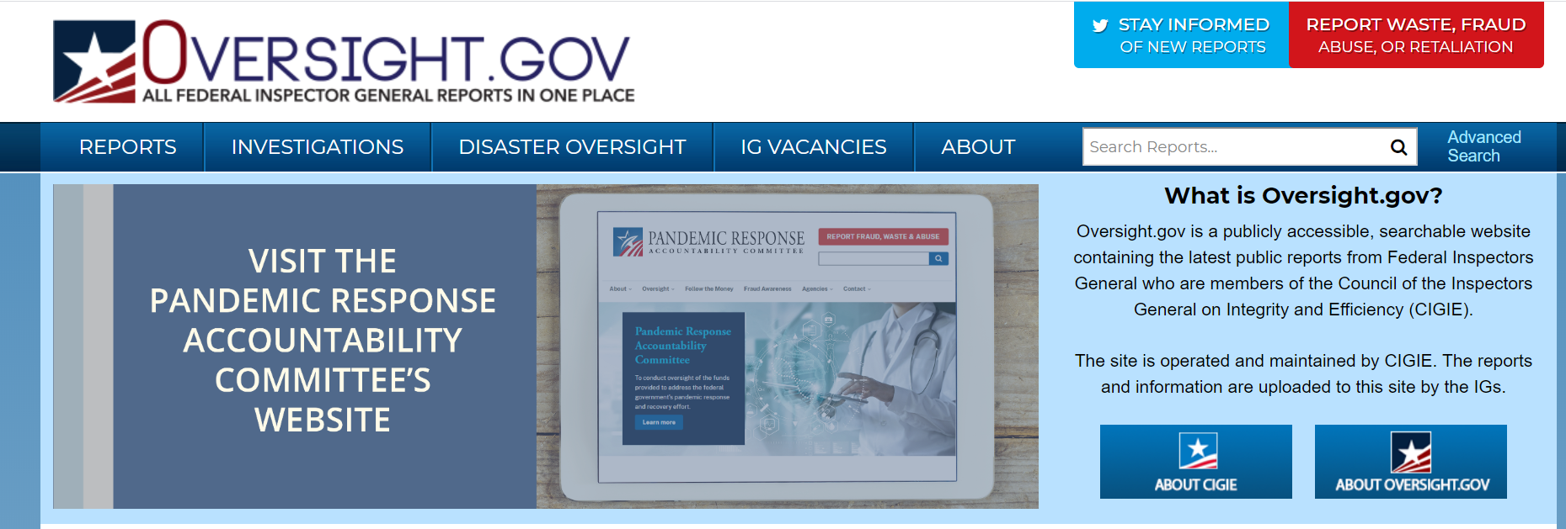
Special Thanks to CIGIE, USPS OIG, and Overight.gov

Slide 14
Phases of Oversight
Phase I
Phase II
Phase III

Slide 15
OIG Audits: Looking Ahead and New Starts
Allocation of Assignments
of Products and Services
Procurement List

Slide 16
OIG Civil Fraud Portfolio
Cases at various investigative stages
Involving nearly $300 million in AbilityOne Contracts

Slide 17
Thank You from the OIG Team
OIG Hotline Toll-Free Number:
(844) 496-1536
Emailing a hotline complaint:
Hotline@oig.abilityone.gov
•

