Slide 1
NCSE CEO Leadership Forum
Thomas K. Lehrich
Inspector General
Virtual Meeting
March 2, 2021

Slide 2
Agenda - Roadmap
CIGIE Top Management Challenges Facing Multiple Federal Agencies
898 Panel Continuity in 2021
Semiannual Report to Congress
OIG 2020 Year End Review
Phases of Oversight
Performance Audits - Program/CNAs
Procurement List Addition Process and Procedures
CNA Selection of NPAs for Project Assignment and Allocation of Orders
Audit of the U.S. AbilityOne Compliance Program

Slide 3
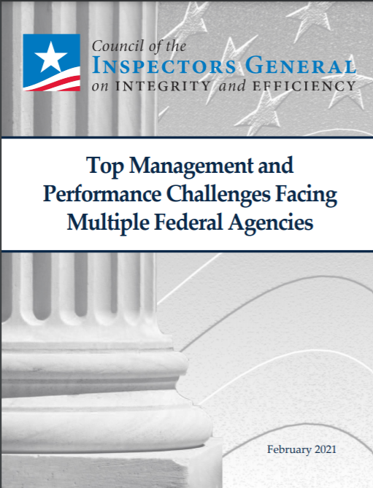
CIGIE Top Management and Performance Challenges Facing Multiple Federal Agencies
Premier resource for the community, the Administration, and other stakeholders that identify and analyze cross-cutting challenges in government
Referenced AbilityOne OIG analysis on enterprise risk management as a cross-cutting government challenge
Referenced AbilityOne OIG report on how the allocation of roles, responsibilities, and resources among the Commission senior staff creates challenges to timely implement policies and initiatives, effectively execute changes, and support growth

Slide 4
CIGIE Top Management and Performance Challenges Facing Multiple Federal Agencies
Cross-Cutting Challenges:
Performance Management and Accountability
Homeland Security, Disaster Management, and Covid-19
Procurement Management
Grant Management
Information Technology Security and Management
Human Capital Management
Financial Management

Slide 5
898 Panel Continuity in 2021
IG Subcommittee has completed both its 898 Panel recommendations
The team brought the recommendations further to expand AbilityOne contract training
As the work of the 898 Panel is completed there are opportunities to identify and leverage recommendations that will continue after sunset of the Panel
The key continuation items we have identified are:
Commission's successful implementation of recommendations by 898 Panel
Focus on continuous updating of the training
Leverage training to reduce program erosion
Ensure training is available and expanded government wide and both within and outside of DoD

Slide 6
898 Panel Continuity in 2021
Implementation of recommendations
Move forward strategically with the legislative language needed to implement Panel recommendations
Continue outreach, collaboration, and communications with the AbilityOne community and stakeholders
Submit the Final Report to Congress

Slide 7
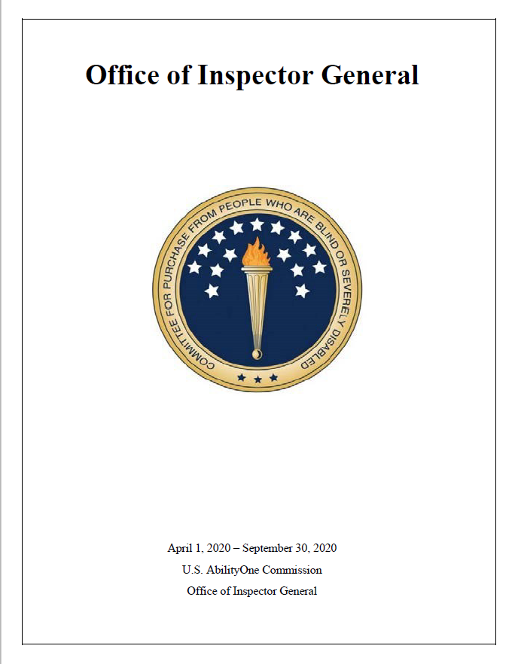
Semiannual Report to Congress
SAR to be issued in April 2021 for period covering October 1, 2020 – March 31, 2021.
Latest SAR issued covered April 1, 2020 – September 30, 2020. Theme: The Future: Tell Your Own Story

Slide 8
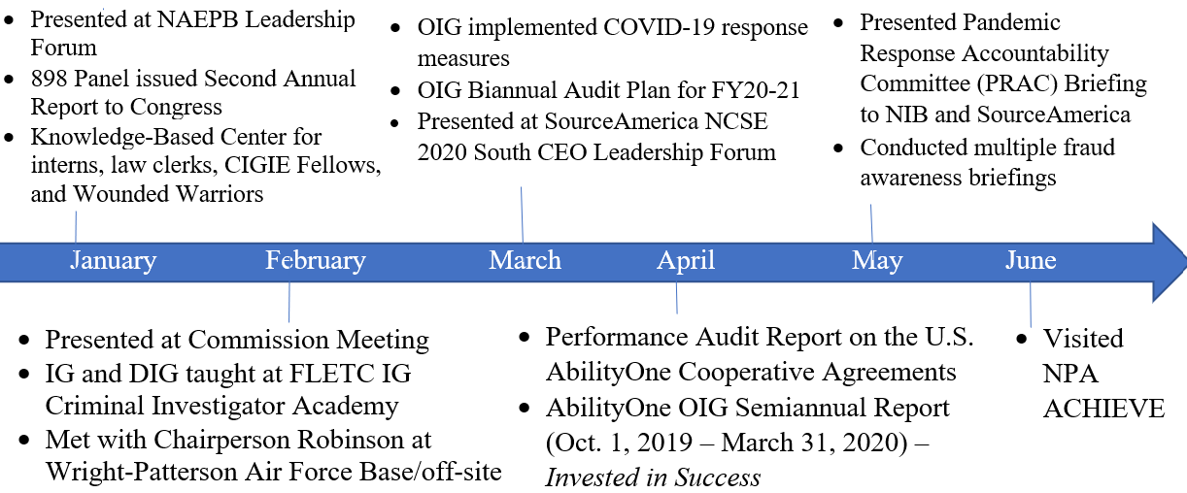
OIG Overview of 2020

Slide 9
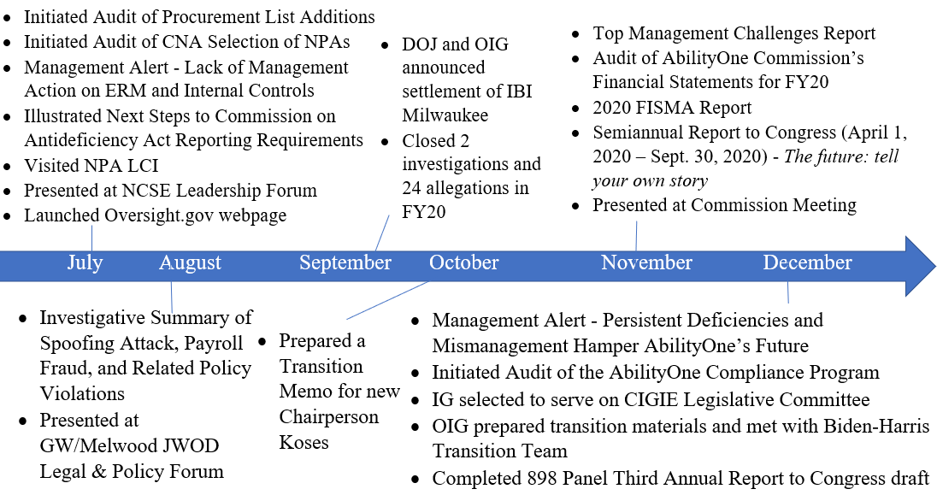
OIG Overview of 2020

Slide 10
Phases of Oversight
Phase I
Phase II
Phase III

Slide 11
Audit of the Procurement List Addition Process, Procedures, and Practices
This is a new audit and fieldwork is in progress
The audit will assess the effectiveness of the policies, procedures, and practices employed by the Commission when approving the addition or removal of products and services for the Procurement List
CNAs’ processes for producing and providing procurement list addition packages

Slide 12
Audit of the Procurement List Addition Process, Procedures, and Practices
The Audit will determine whether the Procurement List addition process is transparent, and performed efficiently, effectively, and in compliance with applicable laws, regulations, and policies
Assess the effectiveness of the Fair Market Price guidance as well as how effective PLIMS supports the program
Audit Report expected completion by second quarter 2021

Slide 13
Audit of the CNA Selection of NPAs for Project Assignment and Allocation of Orders
The fieldwork has been completed and a formal draft report was issued February 22, 2021 for comments
Assess the extent to which the implementation of the project assignment and allocation process by the CNAs is effective and follows established Commission policies
Examine the Commission and CNAs’ policies and procedures as well as best practices for making recommendations to the Commission for NPAs’ project assignments and allocation of orders

Slide 14
Audit of the AbilityOne Compliance Program
This audit will determine whether the Compliance Program has been implemented effectively to provide reasonable assurance of NPA and CNA compliance with applicable laws, regulations, and policies
Review laws, regulations, policies, and procedures applicable to the Compliance Program
Conduct interviews with key personnel
Analyze data, reports, and other supporting documentation related to compliance reviews

Slide 15
OIG Program Visits to Understand the Business of AbilityOne

Slide 16
Q&A
Thank you from the OIG team!

